Slide 1


Shawn Popat
July 4th 2024

Slide 2

Outline
Executive Summary
Introduction
Methodology
Results
Conclusion
Appendix
<number>
Notes:
<number>

Slide 3
Executive Summary
METHODOLOGIES
Determine the price of each launch for the Falcon9.
Gather information about Space X and create dashboards for the team.
Determine if SpaceX will reuse the first stage.
Train a machine learning model from public information to predict if SpaceX will reuse the first stage.
RESULTS
The predictive percentage of a successful landing for the Falcon9
2

Slide 4
Introduction
SpaceY would like to compete with SpaceX
Allon Musk needs to keep costs low by determining launch re-use .
Can we determine the price of each launch?
3

Slide 5

Section 1
4

Slide 6
Methodology
Executive Summary
Data collection methodology:
The data was collected from a sqlite3 database which included the Date, Time, Version, Site, Payload in KG, Orbit, Customer, and Outcomes.
Perform data wrangling
The data collected was used to determine launch sites and outcomes.
Perform exploratory data analysis (EDA) using visualization and SQL
Perform interactive visual analytics using Folium and Plotly Dash
Perform predictive analysis using classification models
Logistic Regression was performed on the data-set for predictive models.
4
Notes:
<number>

Slide 7
Data Collection
A machine learning pipeline was created to predict if the first stage of the Falcon 9 rocket would land in order to determine costs.
6

Slide 8
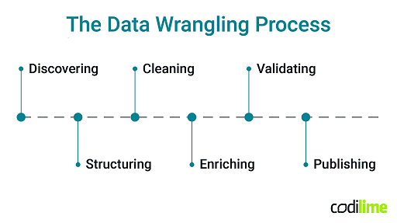
Data Collection – SpaceX API
Define functions, request and parse SpaceX launch data from API.
Falcon 9 launches and outcomes needed to determine cost predictions.
Add the GitHub URL of the completed SpaceX API calls notebook (must include completed code cell and outcome cell), as an external reference and peer-review purpose
7

Slide 9
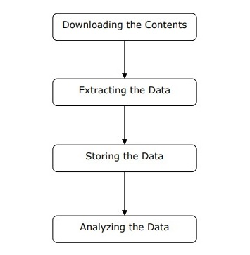
Data Collection - Scraping
Performed scraping to collect Falcon 9 historical launch records from a Wikipedia page titled List of Falcon 9 and Falcon Heavy launches.
Add the GitHub URL of the completed web scraping notebook, as an external reference and peer-review purpose
<number>

Slide 10
Data Wrangling
Data for SpaceX’s Falcon 9 launches were collected and the wrangling process included.
Calculated the number of launches at respective sites.
Falcon 9 orbits for each occurrence was calculated
Number of occurrences of mission outcomes per orbit were calculated.
All landing outcomes were calculated.
Add the GitHub URL of your completed data wrangling related notebooks, as an external reference and peer-review purpose
<number>

Slide 11
EDA with Data Visualization
Scatter plots were used for, PayloadMass and FlightNumber, FlightNumber and LaunchSite, PayloadMass and LaunchSite, Orbit and Outcome, FlightNumber and Orbit, and finally for PayloadMass and Orbit. Graphs and Charts were used to visualize the data.
Add the GitHub URL of your completed EDA with data visualization notebook, as an external reference and peer-review purpose
10

Slide 12
EDA with SQL
SELECT DISTINCT "Launch_Site" FROM "SPACEXTABLE"
SELECT * FROM "SPACEXTABLE" WHERE "Launch_Site" LIKE "CCA%" LIMIT 5
SELECT SUM("PAYLOAD_MASS__KG_") FROM "SPACEXTABLE" WHERE "Customer" LIKE "%NASA (CRS)%
SELECT AVG("PAYLOAD_MASS__KG_") FROM "SPACEXTABLE" WHERE "Booster_Version" LIKE "%F9 v1.1%
SELECT MIN(Date) FROM "SPACEXTABLE" WHERE "Landing_Outcome" LIKE "%Success (ground pad)%
SELECT DISTINCT "Booster_Version" FROM "SPACEXTABLE" WHERE "Landing_Outcome" LIKE "%Success (drone ship)%" AND "PAYLOAD_MASS__KG_" > 4000 AND "PAYLOAD_MASS__KG_" < 6000
SELECT "Mission_Outcome", COUNT(*) FROM "SPACEXTABLE" WHERE "Mission_Outcome" IN ('Success', 'Failure') GROUP BY "Mission_Outcome"
SELECT "Booster_Version" FROM "SPACEXTABLE" WHERE "PAYLOAD_MASS__KG_" = (SELECT MAX("PAYLOAD_MASS__KG_") FROM "SPACEXTABLE")
SELECT "Landing_Outcome", COUNT(*) AS Outcome_Count
FROM "SPACEXTABLE"
WHERE Date BETWEEN '2010-06-04' AND '2017-03-20'
AND "Landing_Outcome" IN ('Failure (drone ship)', 'Success (ground pad)')
GROUP BY "Landing_Outcome"
ORDER BY Outcome_Count DESC
Add the GitHub URL of your completed EDA with SQL notebook, as an external reference and peer-review purpose
11

Slide 13
Build an Interactive Map with Folium
Summary
Marked all launch sites on map
Marked success/failed launches for each site
Calculated distances between launch sites and proximity
To showcase correlations between launch sites and success rates this data was needed to present interactive visual analytics using Folium
Add the GitHub URL of your completed interactive map with Folium map, as an external reference and peer-review purpose
12

Slide 14
Build a Dashboard with Plotly Dash
A Launch Site drop down is included to render scatter plots for ranges of payloads.
Plots were added to show success for missions and locations.
Add the GitHub URL of your completed Plotly Dash lab, as an external reference and peer-review purpose
13

Slide 15
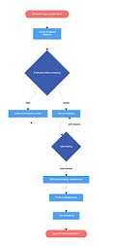
Predictive Analysis (Classification)
After Exploratory Analysis columns were created and the data was standardized and split into training and testing data to perform predictive analysis with the dataset.
14

Slide 16
Results
Exploratory data analysis results
Interactive analytics demo in screenshots
Predictive analysis results
16
Notes:
<number>

Slide 17

Section 2

Slide 18
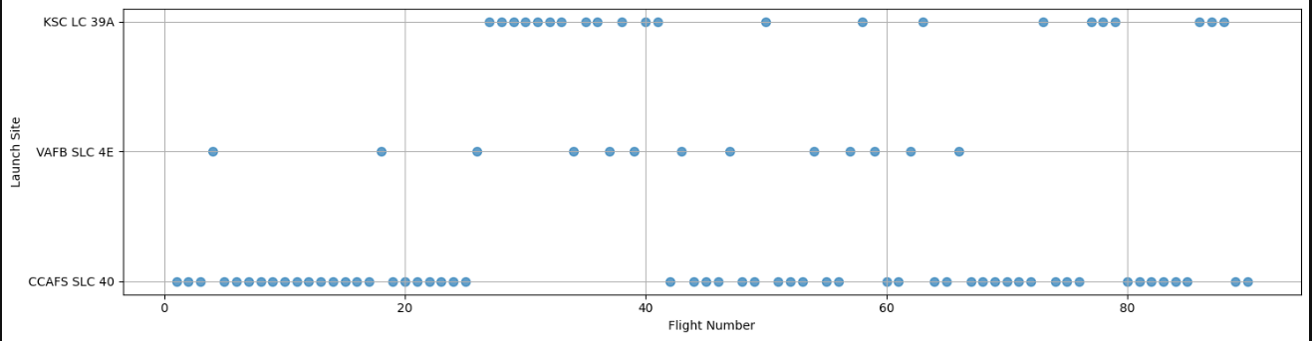
Flight Number vs. Launch Site
Flight Number sequentially listed according to Launch Site
16

Slide 19
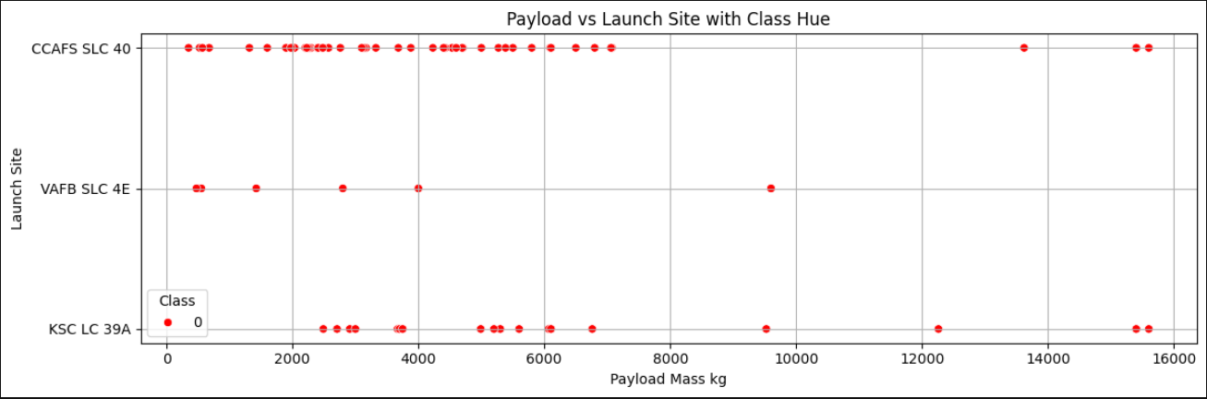
Payload vs. Launch Site
Scatter plot of Payload vs. Launch Site
<number>

Slide 20
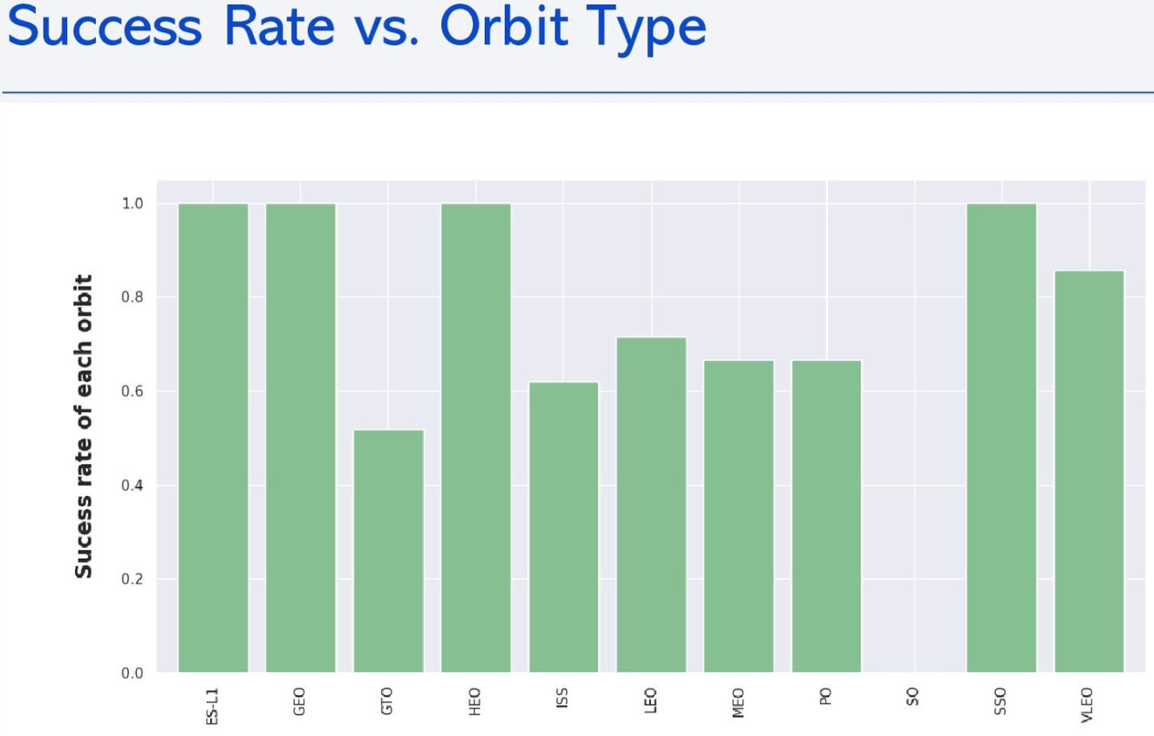
Success Rate vs. Orbit Type
Bar chart for the success rate of each orbit type
<number>

Slide 21
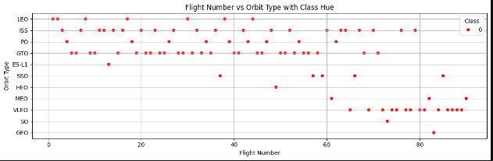
Flight Number vs. Orbit Type
Flight number vs. Orbit type
<number>

Slide 22
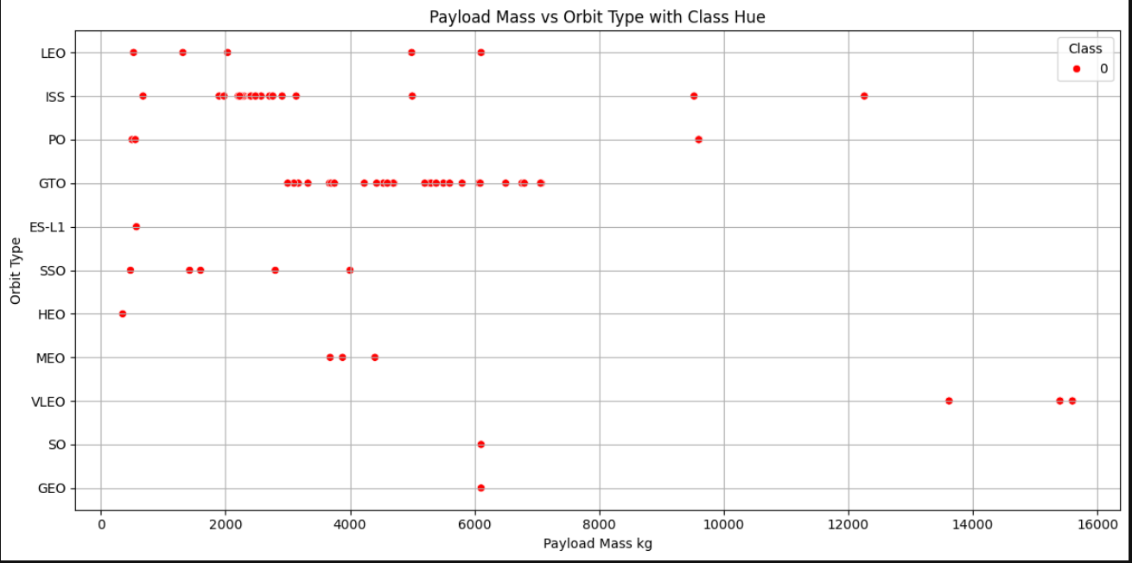
Payload vs. Orbit Type
Show a scatter point of payload vs. orbit type
<number>

Slide 23
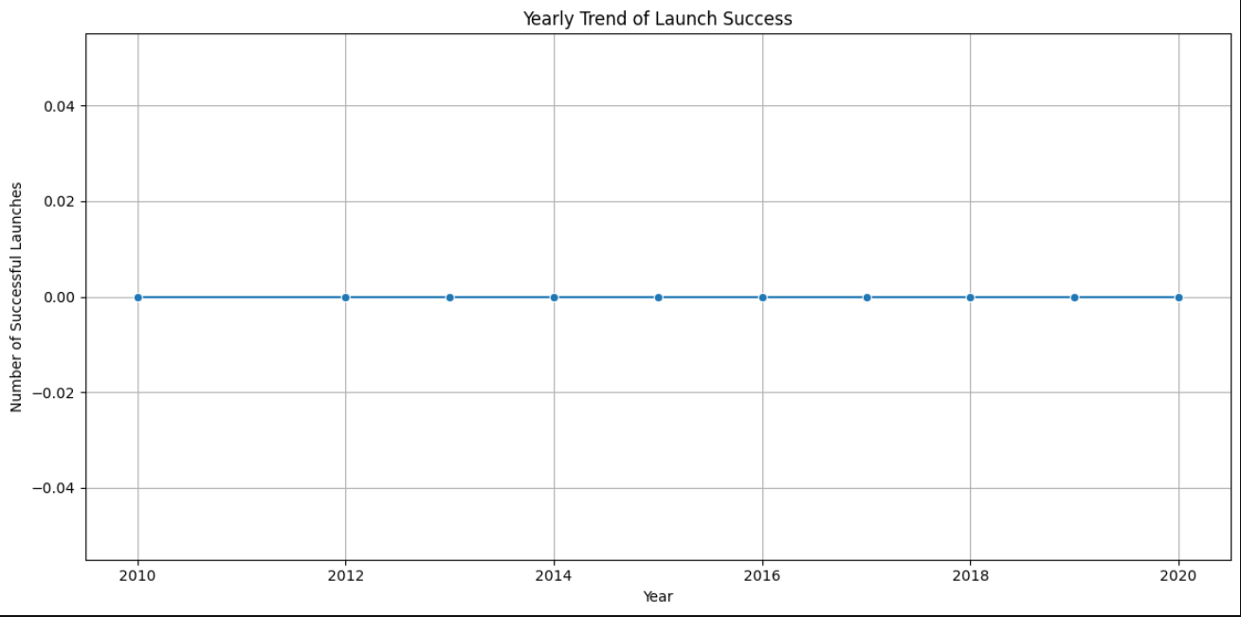
Launch Success Yearly Trend
Yearly Average Success Rate Trend Line
<number>

Slide 24
All Launch Site Names
CCAFS SLC 40
VAFB SLC 4E
KSC LC 39A
Select * Distict ‘LaunchSite’ From SPACEXTABLE;
<number>

Slide 25
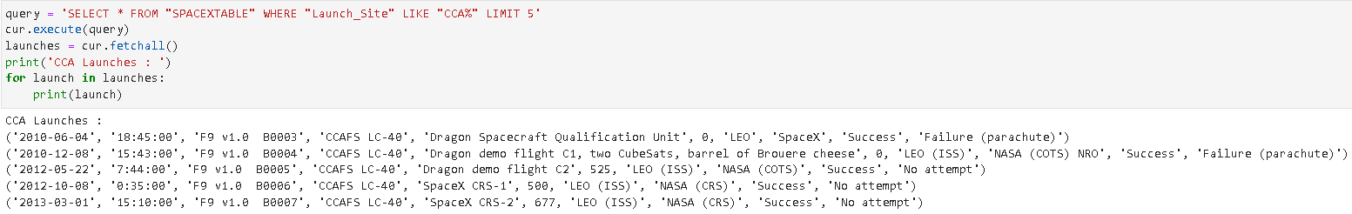
Launch Site Names Begin with 'CCA'
Query used to Find 5 records where launch sites begin with `CCA` presented 5.
24

Slide 26
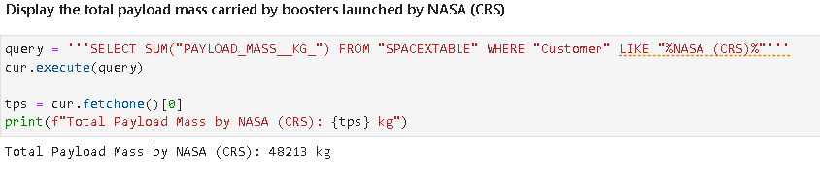
Total Payload Mass
Total payload carried by boosters from NASA
<number>

Slide 27
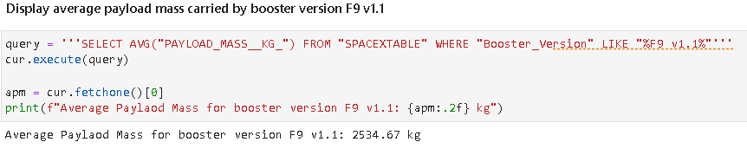
Average Payload Mass by F9 v1.1
Calculate the average payload mass carried by booster version F9 v1.1
<number>

Slide 28
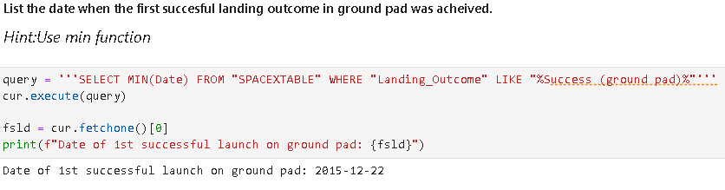
First Successful Ground Landing Date
Find the dates of the first successful landing outcome on ground pad
<number>

Slide 29
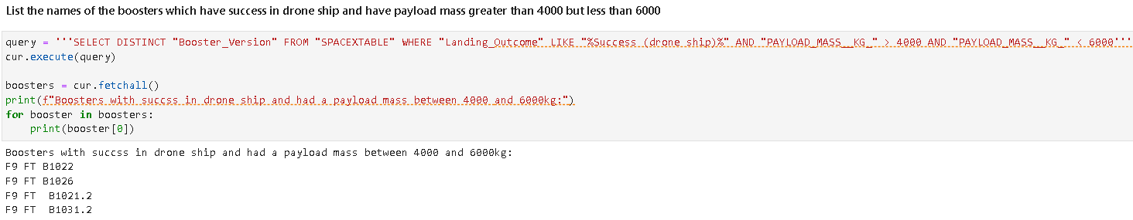
Successful Drone Ship Landing with Payload between 4000 and 6000
List the names of boosters which have successfully landed on drone ship and had payload mass greater than 4000 but less than 6000
<number>

Slide 30
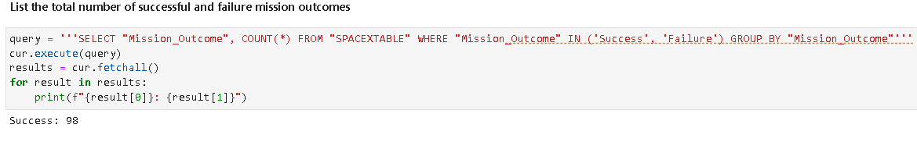
Total Number of Successful and Failure Mission Outcomes
Calculate the total number of successful and failure mission outcomes
<number>

Slide 31
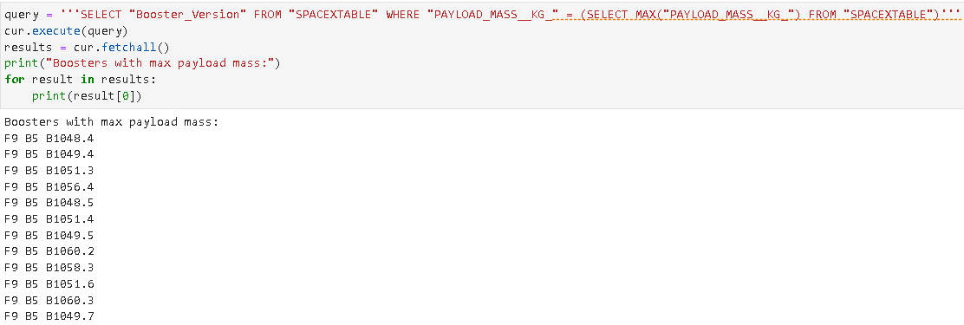
Boosters Carried Maximum Payload
List the names of the booster which have carried the maximum payload mass
<number>

Slide 32
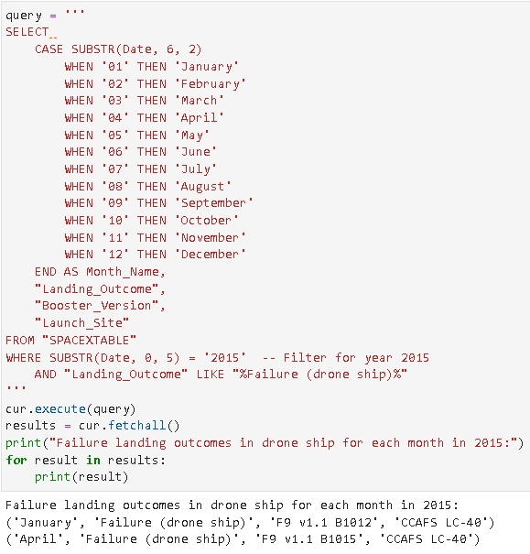
2015 Launch Records
List the failed landing_outcomes in drone ship, their booster versions, and launch site names for in year 2015
<number>

Slide 33
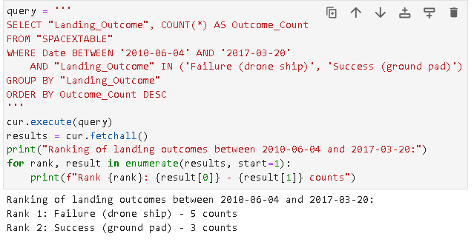
Rank Landing Outcomes Between 2010-06-04 and 2017-03-20
Rank the count of landing outcomes (such as Failure (drone ship) or Success (ground pad)) between the date 2010-06-04 and 2017-03-20, in descending order
<number>

Slide 34

Section 3

Slide 35
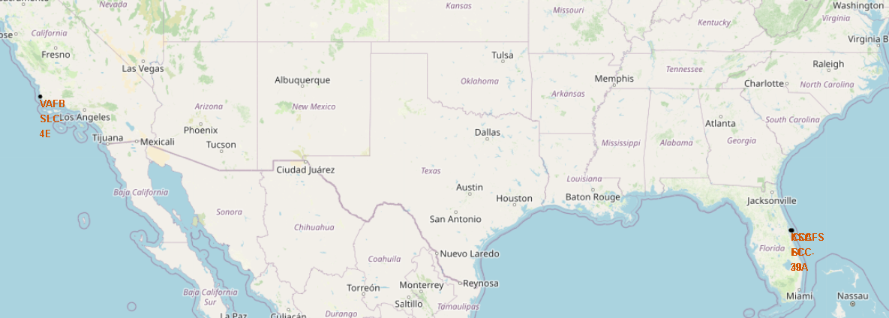
Launch Site Locations
Folium map and screenshot to include all launch sites’ location markers on a global map
<number>

Slide 36
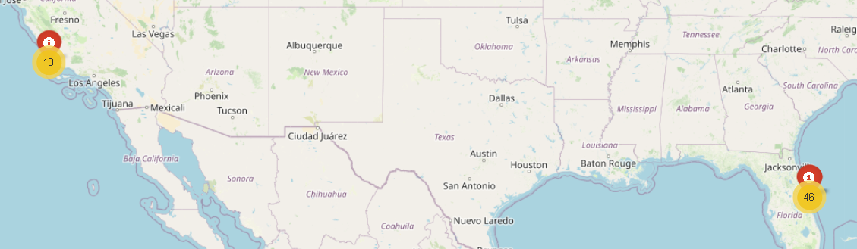
Falcon 9 Launch Outcomes
Folium map screenshot to show the color-labeled launch outcomes on the map
<number>

Slide 37
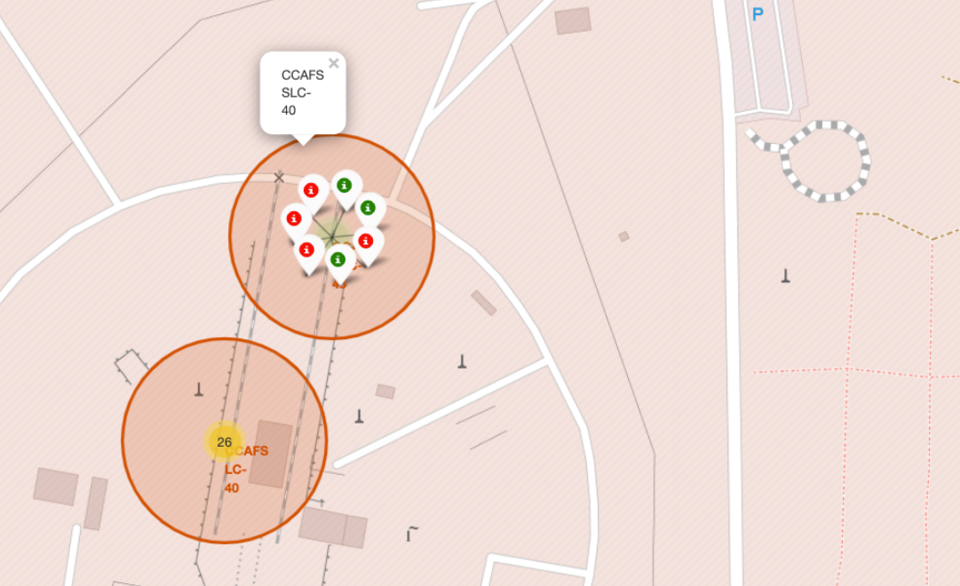
Proximity to Launch Site
Explore the generated folium map and show the screenshot of a selected launch site to its proximities such as railway, highway, coastline, with distance calculated and displayed
<number>

Slide 38

Section 4

Slide 39
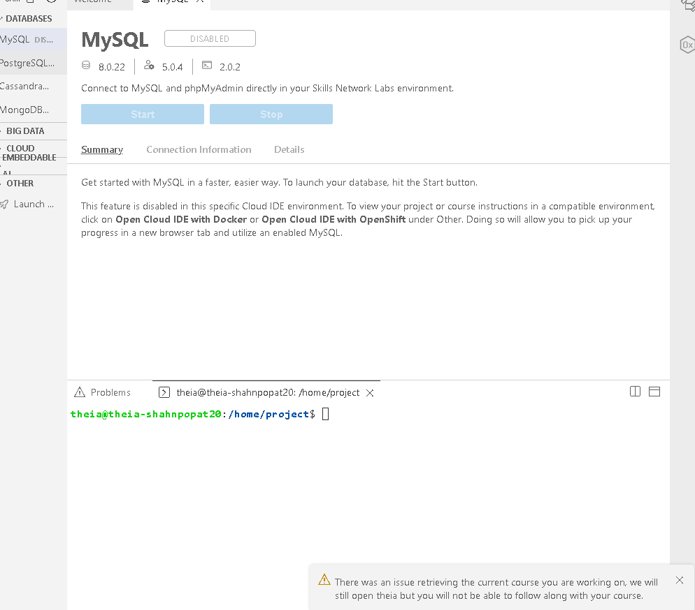
COURSERA NEEDS TO TEST THEIR LESSONS!
<number>

Slide 40
COURSERA NEEDS TO TEST THEIR LESSONS!
<number>

Slide 41
COURSERA NEEDS TO TEST THEIR LESSONS
<number>

Slide 42

Section 5

Slide 43
Classification Accuracy
Visualize the built model accuracy for all built classification models, in a bar chart
Find which model has the highest classification accuracy
<number>

Slide 44
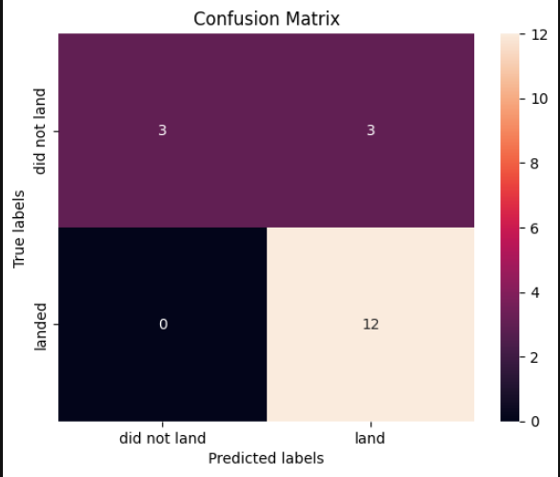
Confusion Matrix
Show the confusion matrix of the best performing model with an explanation
43

Slide 45
Conclusions
The models predict with an 83% confidence level whether a Falcon 9 rocket can be reused.
<number>

Slide 46
Appendix
URL1 = "https://cf-courses-data.s3.us.cloud-object-storage.appdomain.cloud/IBM-DS0321EN-SkillsNetwork/datasets/dataset_part_2.csv" URL2 = 'https://cf-courses-data.s3.us.cloud-object-storage.appdomain.cloud/IBM-DS0321EN-SkillsNetwork/datasets/dataset_part_3.csv'
45
Notes:
<number>

Slide 47


